Slide 1

HOSPITAL NETWORK DESIGN
SIDDHANT MANDAL (RA2011027010079)
PARAG MAHAJAN (RA2011027010088)
SWAGAT S . KALITA (RA2011027010092)
AKELLA SRI RAM (RA2011027010093)

Slide 2
ABSTRACT
In this project we will primarily focus on the network proposal designed for a Hospital. A hospital management software is of utmost necessity in a hospital as the efficient flow of orders and instructions need to be taken to not only work efficiently but also save people’s lives. In this network topology the nodes (i.e., computers, switches, routers or other devices) are connected to a local area network (LAN) and network via links (twisted pair copper wire cable or optical fiber cable). We have used Cisco Packet Tracer for designing the network topology. It is a general design which can be implemented at any higher level to manage network systems.

Slide 3
PROJECT SCOPE
A network proposal has to be designed for a hospital which has the following. There is a main block and three wards in the campus. The main block is the administrative block where registration of new patients takes place. The main block has 3 floors. The hospital has identified hospital management software, which should be accessible by the employees. The software is installed on a server at the administrative block. On the ground floor, there are 10 computers in the billing section. At other floors, there is one computer user each. The farthest distance between the computer on the top most floor and the ground floor is less than 70 meters. The wards have 3 floors each, with 5 computers in the ground floor of each ward. The distance between the wards and the blocks are less than 80 Meters. The computers in the wards may be increased based on future expansion plans.

Slide 4
OBJECTIVE
The main objective of this project is to design a network for a hospital with given constraints. With the given constraints, we have a Main block with 10 nodes and three Clinical wards with five nodes each connected to the main block. The main block also includes two additional floors with one node each. All these nodes are dynamically assigned IP addresses through a server in the main block using Dynamic Host Configuration Protocol (DHCP). We also set up a simple webpage on our website and gave it a generic name using a Domain Name Subsystem (DNS) Server.

Slide 5
NETWORK REQUIREMENTS
Hardware requirement analysis in the main block with quantity.
Hardware requirements analysis in wards.
The employees should receive dynamic IP addressing from a central server.
Network should be loop free at Layer 2.
Every computer should be able to access the hospital management software from each of the locations using a fixed IP address.
IP Network design table.
Identify configurations on the hardware wherever appropriate. 8. Network topology diagram with necessary equipment.
Websites and webpages using DNS server.

Slide 6
NETWORK REQUIREMENT ANALYSIS
There are total 4 modules in our project :
Main Building (with 3 floors)
Ward A
3. Ward B
4. Ward C

Slide 7
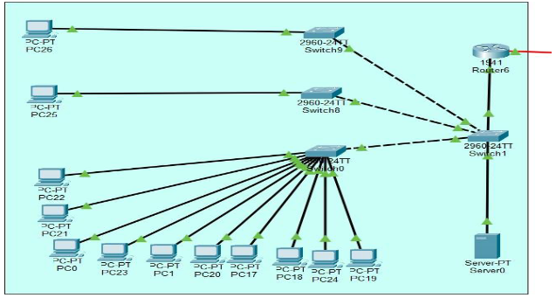
MAIN BUILDING
MODULE DESCRIPTION
It is the main unit with 3 floors in it. Each floor is connected to a switch and further all the switches are connected to a router. There are 10 pcs in 1 floor and 1 pc in floors 2 and 3. There is a server connected to the router through a switch.

Slide 8
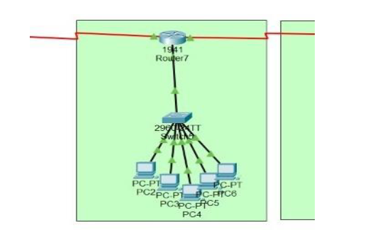
WARD A:
MODULE DESCRIPTION
This is our first ward. It is connected to our main building via router. PCs inside the ward are connected via switch and then that switch is connected to the router.

Slide 9
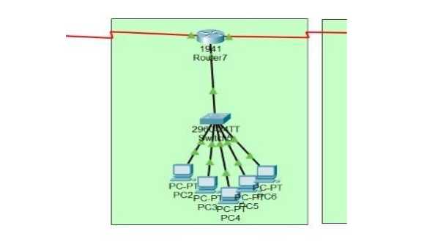
MODULE DESCRIPTION
WARD B:
This is our second ward. It is connected to our main building via router. PCs inside the ward are connected via switch and then that switch is connected to the router.

Slide 10
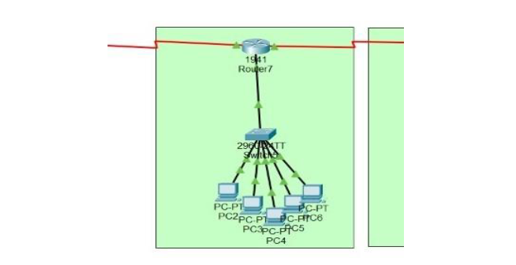
MODULE DESCRIPTION
WARD C:
This is our third ward. It is connected to our main building via router. PCs inside the ward are connected via switch and then that switch is connected to the router.

Slide 11
CONFIGURATION GUIDELINES
In the main ward we have 10 Pcs on the ground floor and one PC each on the first and second floors. These PCs are all connected to one router. This configuration is further connected in the bus topology to the three clinical wards. We chose to connect the routers in a bus-like topology so that we can easily implement more blocks with their own network configurations in the future. Each ward has 1 router connecting 5 PCs to it. These are all LAN configurations. IPs are dynamically allocated to every node through DHCP protocol from the server. DHCP automates and centrally manages these configurations rather than requiring network administrators to manually assign IP addresses to all network devices. The routers and nodes are also connected in a star topology within each building/block. Routing is done in all the configurations through RIPv1 routing. Finally, we use the DNS Server to set up a simple web page showing a hospital menu and some links to navigate within the website.

Slide 12
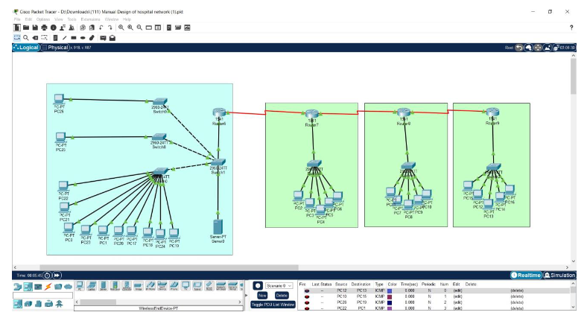
PROJECT SCREENSHOT

Slide 13
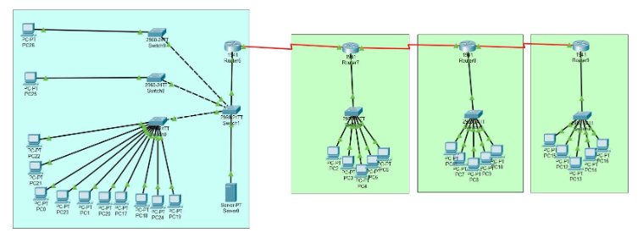
NETWORK TOPOLOGY DIAGRAM
It is a Hybrid topology which consists of 4 star topology which is connected via a bus topology.

Slide 14
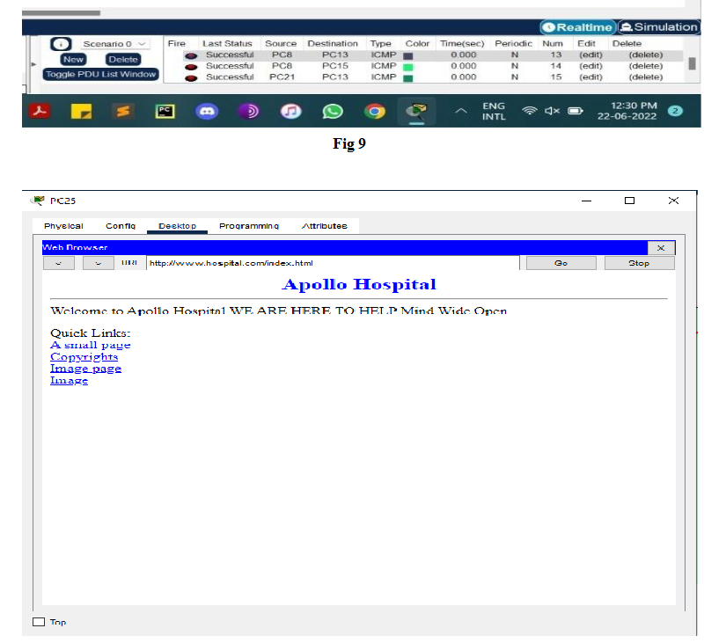
TESTING AND VERIFICATION

Slide 15

THANK YOU

